Slide 1
Directed Graph
Injung Kim
11/1/2019

Slide 2
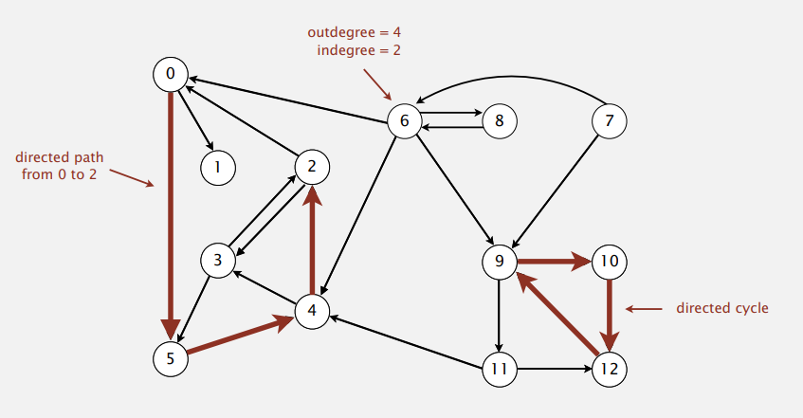
Directed graphs
Digraph. Set of vertices connected pairwise by directed edges.

Slide 3
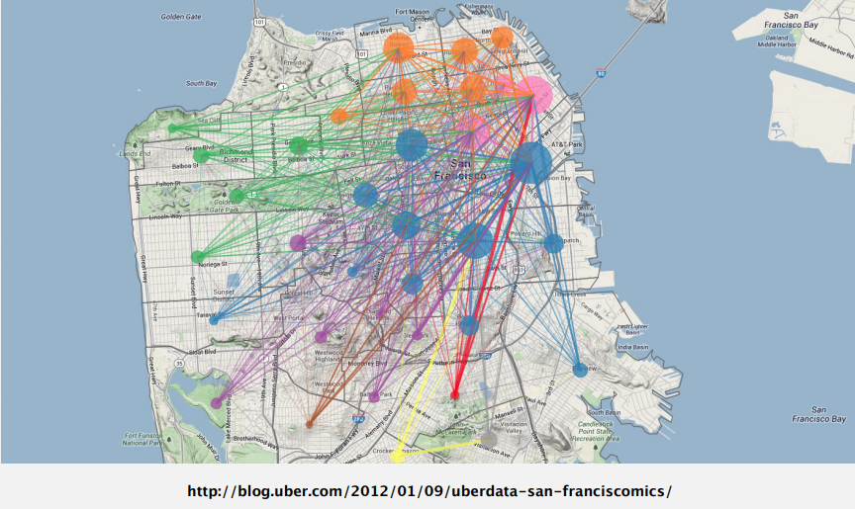
Uber Taxi Graph
Vertex = taxi pickup ; Edge = taxi ride

Slide 4
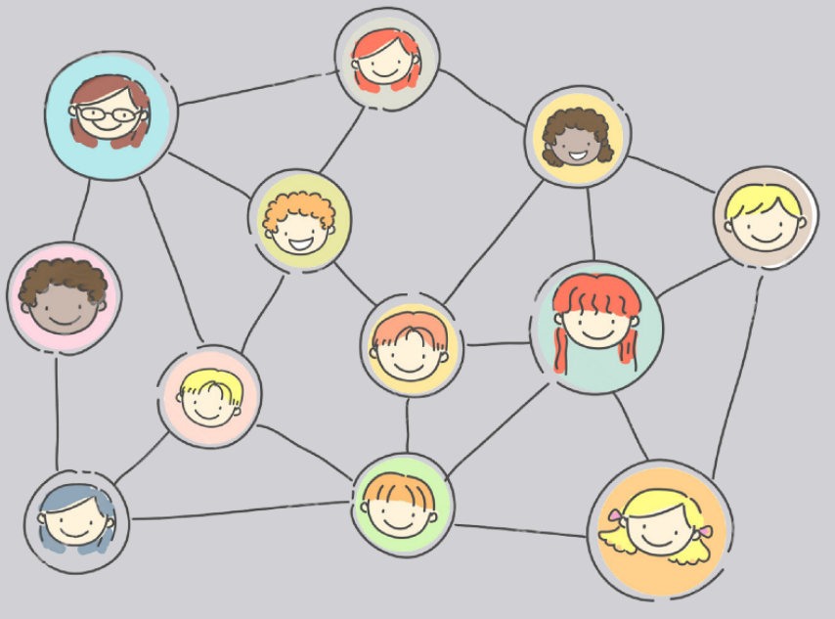
Social Network Graph
Vertex = person ; Edge = friends

Slide 5
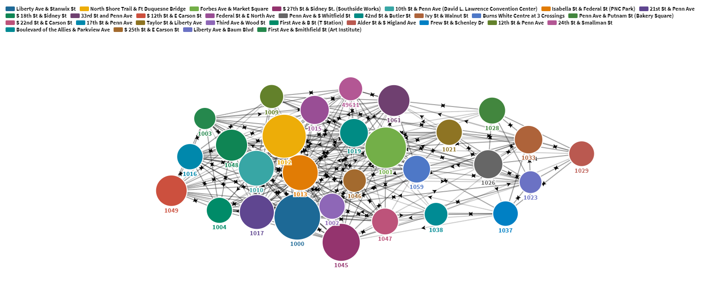
Bike Sharing System Graph
Vertex = bike station ; Edge = trips

Slide 6
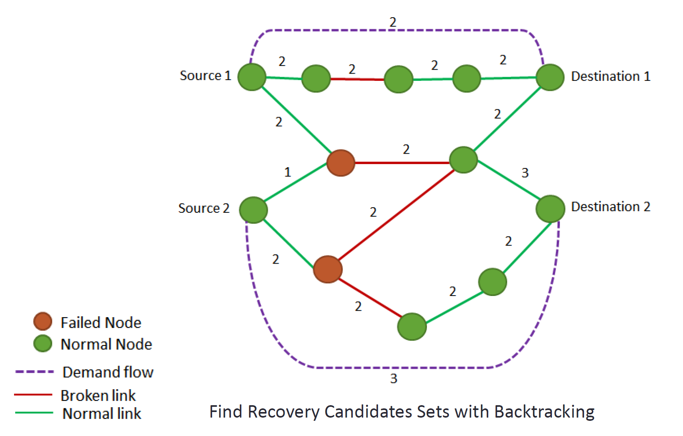
Network Recovery System Graph
Vertex = network device ; Edge = capacity needs

Slide 7
Today Lab: Airline Digraph
Vertex = city; Edge = flights
Harrisburg
Philadelphia
Pittsburgh
Allentown

Slide 8
Today Lab: Airline Digraph - Input
4
Pittsburgh
Erie
Altoona
Johnstown
1 2
1 4
1 3
4 1
3 4
4 3
// Number of cities = Number of vertex
// Cities = build an array or so
// edge information = build a Diraph

Slide 9
Today Lab: Airline Digraph – Expected Output
Pittsburgh: Erie Altoona Johnstown
Erie:
Altoona: Johnstown
Johnstown: Altoona
//Start: Destination

